Slide 1
How do I use this web page?
Introduction to Automotive Technology
By Instructor V. Bloom

Slide 2
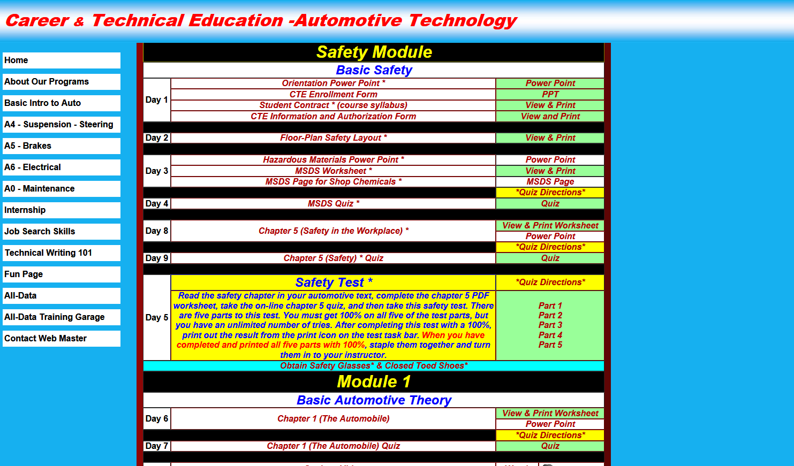
The links in the right column with the green background are required- Do them!
4
5

Slide 3
Do them in order from top to bottom! (The assignments are designed to be done in this specific order)

Slide 4
The links with white, yellow, and blue backgrounds are there to assist you with completing the assignments in green. (The white, yellow, and blue links are usually near the task that they help with)

Slide 5
The links with yellow that say “Quiz Directions” will tell you the password for the quiz, how to fill out the information that the quiz asks for (like name, period, etc…), and how to print the successfully completed quiz. (These links are near the quiz that they help with)

Slide 6
The links with white are information (like power points) that are there to assist you with completing the assignments in green. (The white links are usually near the task that they help with)

Slide 7
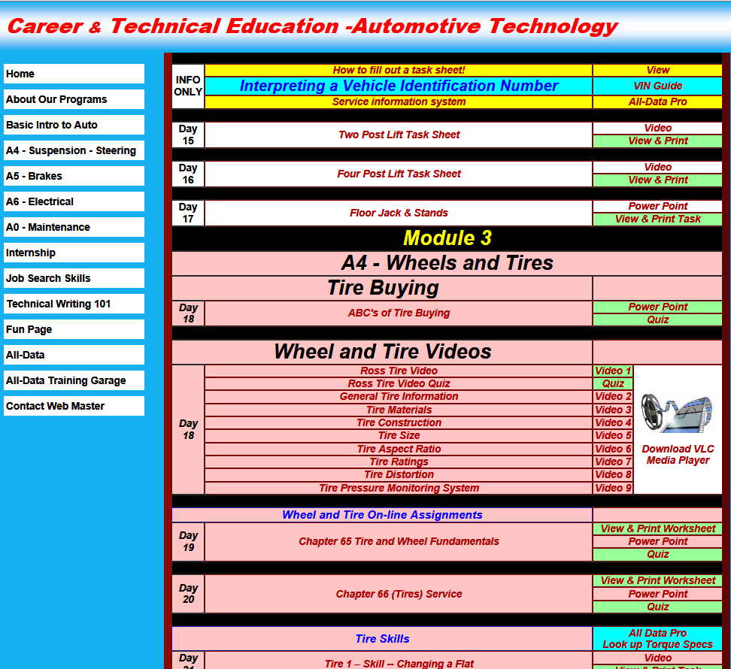
The links with blue are resources that are there to assist you with completing the assignments in green. (The blue links are usually near the task that they help with)

Slide 8
Questions?
Watch this power point again
Ask three other students in the class
Ask the instructor (did you do 1 & 2 first?)

Slide 9
The End

